Slide 1
FOOD TRENDS:
Based on Customer Satisfaction
TEAM-05
Under the Guidance:
Pavithra Kannan mam

Slide 2
TEAM MEMBERS:
01
Hema Latha
02
Samvedita Bisariya
03
Dipa Majumder
04
Udit Mathur

Slide 3
Overview: Identified actionable customer personas using advanced segmentation and sentiment analysis
Objective: Classify and visualize personas for targeted insights across age, cuisine, and visit frequency.
Key Activities:
Developed segmentation algorithms integrating customer sentiment and interaction frequency.
Created personas reflecting unique customer behavior patterns.
Built an interactive dashboard for exploring personas by age, cuisine preference, and visit frequency.
Outcome: The dashboard now enables quick, data-driven persona insights across behavioral and demographic filters, allowing stakeholders to better target, engage, and retain customer segments.

Slide 4
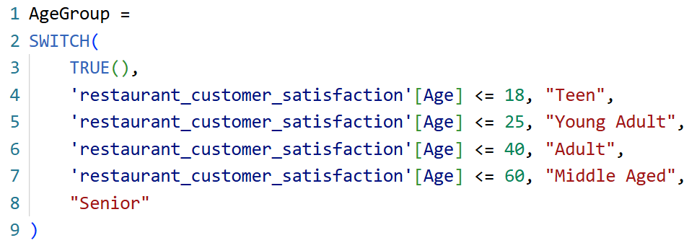
Data Enhancements for Persona Segmentation
To advance our analysis, we created two key calculated columns- Persona and AgeGroup using DAX formulas, empowering precise customer segmentation and driving actionable business insights.
[1] AgeGroup column:
Classifies customers into distinct demographic segments: Teen, Young Adult, Adult, Middle Aged, and Senior. The formula logic is shown in the image for transparent calculation across all ages.

Slide 5
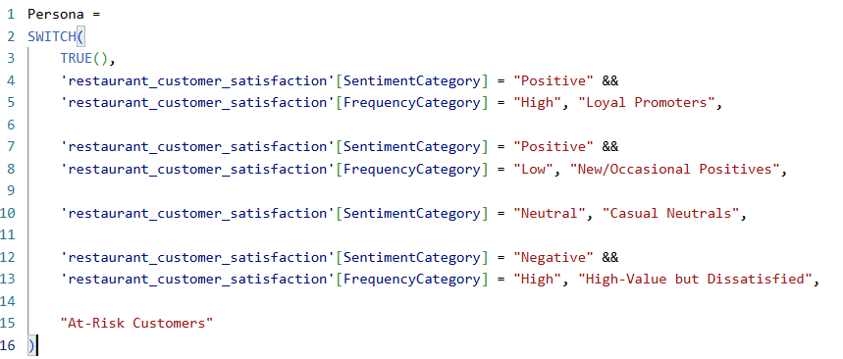
Data Enhancements for Persona Segmentation
[2] Persona column:
Segments customers into actionable personas based on sentiment and visit frequency, including Loyal Promoters, New/Occasional Positives, Casual Neutrals, High-Value Dissatisfied, and At-Risk Customers. The categorization logic is presented in the formula image for clarity.

Slide 6
Power BI Visual Built
(A) Overview KPIs (Top Row):
Total Customers: Displays the total count of unique customers analyzed.
Average Rating: Provides a snapshot of average customer satisfaction scores across all segments.
Average Sentiment: Represents the mean sentiment score from feedback and reviews.
(B) Filters & Segmentation (Top Row):
Cuisine and Age Group Filters: Allow users to dynamically filter all dashboard visuals by cuisine type and customer age group to examine behavioral and demographic trends with precision.
(C) Persona Distribution (Donut Chart):
Illustrates the proportion of each customer persona, such as At-Risk Customers, Loyal Promoters, Casual Neutrals, etc.
Visually quantifies and compares persona group sizes for immediate strategic insight.
(D) Persona % Share by Visit Frequency (Area Chart):
Displays how different personas distribute across visit frequency (daily, weekly, etc.)
Helps identify which persona segments are most frequent or occasional, aiding targeted engagement.

Slide 7
Power BI Visual Built
(E) Count by Age Group & Persona (Stacked Bar Chart):
Breaks down customer counts by both persona and age group.
Provides demographic overlay to reveal which age segments dominate specific personas.
(F) Count by Cuisine & Persona (Stacked Bar Chart):
Shows how various personas are distributed across cuisine types, supporting cuisine-specific strategies for marketing and retention.
(G) Sentiment Analysis by Cuisine (Multi-Line Chart):
Visualizes positive, neutral, and negative sentiment percentages for each cuisine.
Enables comparison of dining experience sentiments across different offerings.
(H) Sentiment Analysis by Persona (Stacked Bar Chart):
Compares the proportion of positive, neutral, and negative sentiment within each persona.
Offers actionable insights for improving customer experience for targeted persona segments.

Slide 8
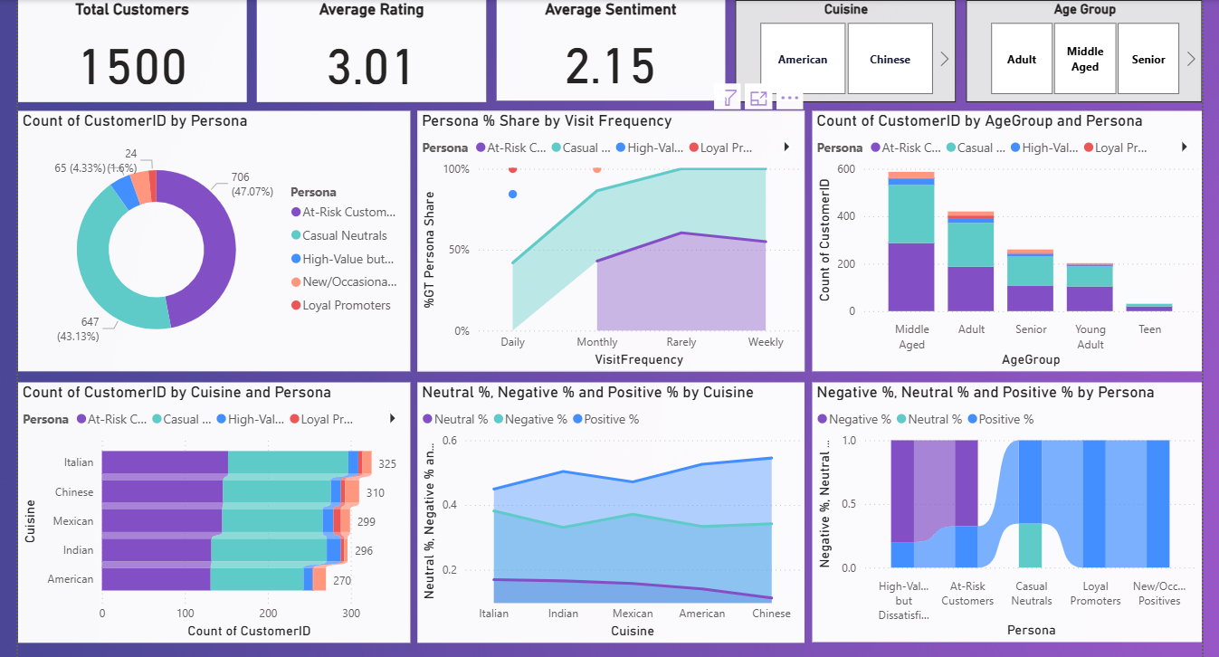
  OUTPUT:

Slide 9
Business Value
Strategic Customer Targeting:
Persona and age group segmentation empower more precise targeting for marketing and service initiatives, helping identify and engage each customer group based on behavior and preferences.
Personalized Experience Delivery:
By classifying customers into actionable personas and demographic segments, the dashboard enables delivery of tailored promotions, recommendations, and loyalty programs, thereby enhancing satisfaction and retention.
Optimized Resource Allocation:
Insights into persona frequency, cuisine preferences, and age demographics inform operational decisions, allowing more efficient allocation of staff, inventory, and marketing resources to priority segments.
Revenue Growth & Loyalty Enhancement:
Segment-focused strategies, such as special offers for Loyal Promoters or service improvements for High-Value Dissatisfied segments, drive repeat business, increase lifetime value, and maximize overall revenue potential.

Slide 10
CONCLUSION
Comprehensive Segmentation Analysis:
The project delivers an enriched, multidimensional view by integrating customer personas and age groups, providing deeper insights into customer behavior and demographics.
Advanced Calculations & Visualizations:
The use of dynamic DAX measures and intuitive visuals translates complex segmentation data into straightforward, actionable insights.
Strategic Business Impact:
Insights uncovered from persona and demographic segmentation support targeted marketing, personalization of customer interactions, and enhanced business growth opportunities.
Future Scope:
The analytics framework is designed to easily incorporate new segmentation criteria and advanced visualizations, enabling continuous improvement and expanding business intelligence capabilities.

Slide 11
THANK YOU

